Slide 1


ROUTE CALCULATION FOR TRAVELLING ON CITIES WITH HIGHER HARASSMENT RATE

Slide 2

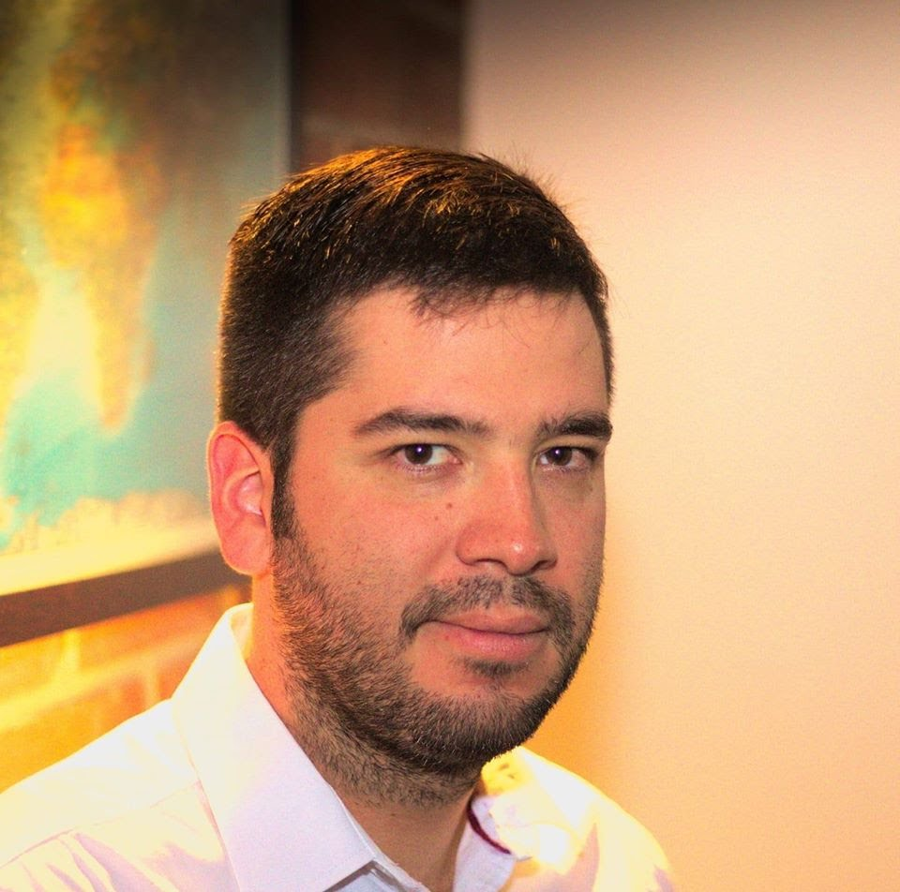
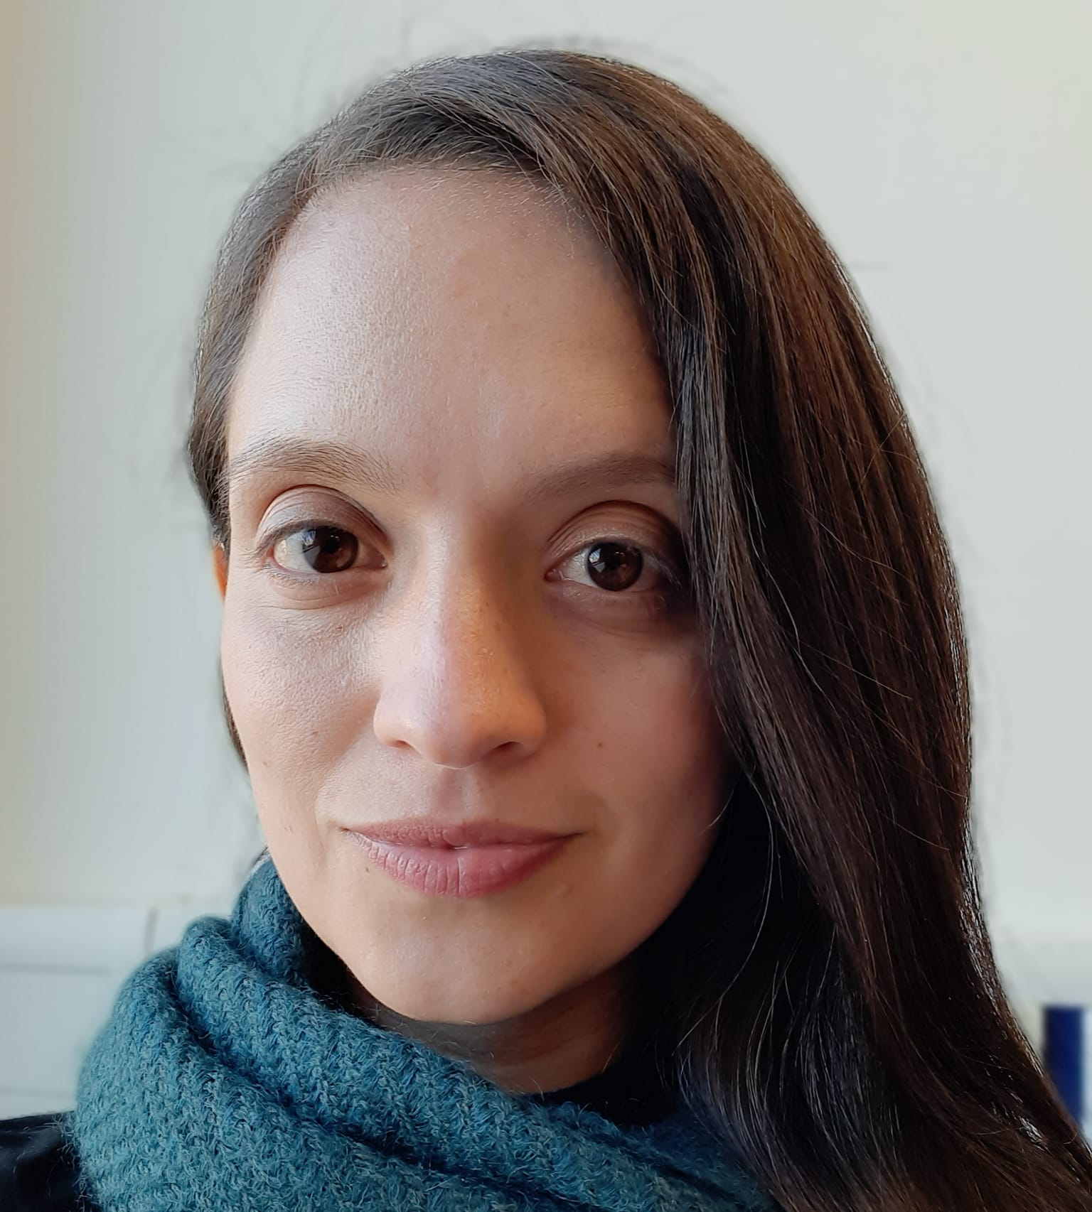

Team Presentation
Andrés Caro
Writing, coding
Andrea Serna
Literature review
Mauricio
Toro
Data preparation
https://github.com/WhiteTeaCup/ST0245-001

